Slide 1
Education and Training Inspectorate Inspection and improvement A Partnership
14 September 2015

Slide 2
Purpose of today
To:
Demonstrate even greater transparency in how ETI inspects
promote greater engagement and collaborative working
update you on recent developments in inspection
demonstrate the link between inspection and self-evaluation
outline the inspection processes for your phase.

Slide 3
Education and Training Inspectorate Inspection and improvement A Partnership
14 September 2015
NOELLE BUICK CHIEF INSPECTOR

Slide 4
Purpose of inspection
Using first hand evidence, identify, promote and effect improvement
by ensuring:
best practice is highlighted and shared
poor provision is identified and supported to improve
we build capacity for further improvement.
In so doing we provide:
parents/carers with reassurance that their children are safe and well educated
departments (that we inspect for) with evidence-based policy advice and robust accountability mechanisms.

Slide 5
Standing International Conference of Inspectorates (SICI)
Important emerging trends in inspection:
Inspectorates to be agile – focus on risk and proportionality.
A strengthening of the catalytic and capacity‐building contributions of inspection.
Inspection must not take away the responsibility for high quality from organisations themselves.
Self‐evaluation leading to improvement rather than passive compliance with an externally determined agenda is central to sustained enhancement in the quality of students’ learning.

Slide 6
How does ETI build capacity?
by:
promoting processes of evaluation which will endure beyond the period of the inspection
helping to establish improved ways of working through professional dialogue on inspection and district visits
identifying and disseminating examples of sector-leading practice from which others learn
involving Associate Assessors in our work.

Slide 7
OECD study of evaluation and assessment in NI (December 2013)
Stated that:
there are well established mechanisms for external school evaluation (inspection)
inspection is based on quality assurance and emphasises school improvement
the framework for inspection is supported by international effectiveness research
the framework is published and promoted for school use and which ensures transparency in the criteria used.

Slide 8
Education Committee’s Inquiry into ETI and School Improvement
Report June 2014 stated:
‘A professional, independent, broadly based, balanced inspection service is an essential component of the school improvement process’
Many of the recommendations were already work in progress and today we will demonstrate the outcomes of this work.

Slide 9
10 principles of inspection in the public sector
Focus on:
improvement of the provision being inspected
outcomes – the service being delivered for learners
the user perspective – the experience of learners
being proportionate to risk
value for money
self-assessment – encouraging it to be rigorous
impartial evidence: validated, credible, qualitative quantitative
disclosing the criteria for inspection
open and transparent inspection processes
continuous learning from the experience of inspection.

Slide 10
ETI’s strategic objectives 2013-16
Promoting improvement through inspection.
Disseminating good practice and building capacity across all education and training.
Providing sound, evidence-based advice to inform policy.
Engaging effectively with learners, parents, the organisations we inspect and stakeholders.
Reviewing continuously inspection practice to be open and transparent, proportionate to risk and ensure value for money.
Developing further a motivated, highly-valued workforce responsive to changes in education and training.

Slide 11
Revisions to inspection - implemented
reduced notice period for most of our inspections - 2 weeks
inspection findings are reported on Friday on one week inspections
prompt (short) feedback after lessons
online parent and staff questionnaires
revised report structure September 2013
revised post-primary model September 2013
piloted streamlined 2 day primary model 2014/15
whole-college inspection model for FE 2012

Slide 12
Revisions to inspection – current
Revised performance levels and conclusions for overall effectiveness.
Role of the Representative.
Joint lesson observations.
Inspection handbook.
Sustaining improvement inspections.
Pre-inspection day for RI on 2+ day inspections.

Slide 13
NISRA - post inspection survey 2014-15
Gathering information did not place undue burden (85% agreed).
Opportunity to:
Brief inspection team on context (90% agreed).
Provide inspectors with appropriate range of information (87%).
Final report back, team communicate clearly (96% agreed).
Inspection process helped the organisation plan for and promote improvement (81% agreed).
Customer Service Excellence – ETI exceed the standard.

Slide 14
Promoting improvement in the interest of all learners
ETI aims for the inspection process to:
be challenging but also positive and constructive
be highly credible and fully understood
be flexible and responsive to a changing landscape
demonstrate partnership working and collaborative responsibility
have a positive impact on improvement beyond the inspection itself.

Slide 15
Inspection and self-evaluation
Paul McAlister
Assistant Chief Inspector

Slide 16
Improving Quality: Raising Standards (IQ:RS) Together Towards Improvement (TTI)
The ETI inspection team evaluates using either IQ:RS or the TTI quality indicators which were each written for
self-evaluation in different contexts.
How effective are leadership and management in raising achievement and supporting learners?
How effective are planning, teaching, learning and assessment in raising achievement and supporting learners?
How well do the learning experiences, programmes and activities meet the needs of the learners and the wider community?
How well are learners cared for, guided and supported?
How well do learners develop and achieve?

Slide 17
Inspection and self-evaluation
Vertical and horizontal accountability.
On-going and sharply focused.
Clear and agreed view.
Informs and influences.
Involves critical evaluation and reflection.

Slide 18
Performance levels and overall effectiveness outcome
John Baird
Assistant Chief Inspector

Slide 19
Changes to performance level descriptors from September 2015
Previous descriptor | New descriptor from Sept 2015
Outstanding | Outstanding
Very Good | Very Good
Good | Good
Satisfactory | Important area(s) for improvement
Inadequate | Requires significant improvement
Unsatisfactory | Requires urgent improvement

Slide 20
Changes to performance level descriptors from September 2015
One of the six performance level descriptors will be applied to each of:
Achievement and Standards
Quality of Provision
Leadership and Management
creating a profile which will lead to one of four inspection outcomes for overall effectiveness.

Slide 21
Six performance levels across the three key indicators leads to one of four inspection outcomes for overall effectiveness
The school has a high level of capacity for sustained improvement in the interest of all the learners. ETI will monitor how the school sustains improvement.
The school demonstrates the capacity to identify and bring about improvement in the interest of all the learners. ETI will monitor how the school sustains improvement.

Slide 22
Six performance levels across three key indicators leads to one of four inspection outcomes for overall effectiveness
The organisation has a high level of capacity for sustained improvement in the interest of all the learners. The ETI will monitor the organisation’s progress in addressing any area(s) for improvement through its annual scrutiny inspection.
The organisation demonstrates the capacity to identify and bring about improvement in the interest of all the learners. The ETI will monitor the organisation’s progress in addressing the area(s) for improvement through its annual scrutiny inspection.

Slide 23
Six performance levels across the three key indicators leads to one of four inspection outcomes for overall effectiveness
The school needs to address (an) important area(s) for improvement in the interest of all the learners. ETI will monitor and report on the school’s progress in addressing the area(s) for improvement. There will be a follow-up inspection within 12-18 months.
The school needs to address urgently the significant areas for improvement identified in the interest of all learners. It requires external support to do so. ETI will monitor and report on the school’s progress in addressing the area(s) for improvement. There will be a follow-up inspection within 18-24 months.

Slide 24
Six performance levels across three key indicators leads to one of four inspection outcomes for overall effectiveness
The organisation needs to address (an) important area(s) for improvement in the interest of all the learners. The ETI will monitor and report on the organisation’s progress in addressing the areas for improvement which includes the need to produce an improvement plan, which will be the basis for a formal follow-up inspection process within 12-18 months.
The organisation needs to address urgently the significant areas for improvement identified in the interests of all the learners. The ETI will monitor and report on the organisation’s progress in addressing the areas for improvement, which includes the need to produce an improvement plan, which will be the basis for a formal follow-up inspection within 12-18 months.

Slide 25
Increased Engagement on Inspections
Alison Chambers
Assistant Chief Inspector

Slide 26
Role of Representative
Organisation nominates a representative
The uptake is voluntary
Attends all inspectorate team and moderation meetings
Representative is free to not attend any meeting or leave part of any meeting
Approach piloted in the past academic year
Consultation/evaluation took place on the outworking of the process

Slide 27
Outcome of pilot
Very positive both from Representatives and Teaching Unions
.... as an open and transparent process
Representatives
felt more involved
had the opportunity to signpost additional evidence
may not agree with evaluation but understand the evidence and the rationale
Representatives appreciated
the professional manner in which the team and RI conducted the inspection
that there is robust, rigorous, challenging and professional debate

Slide 28
Joint lesson observations
Openness and transparency through collaborative working
Offer made to principal/leader to observe two or three lessons jointly with an inspector
during Post Primary and 5-day Primary, Special, Further Education, and Work-Based Learning inspections
Lessons visited with the consent of the teachers/lecturers/tutors concerned
To discuss jointly with ETI the evidence and evaluation of the effectiveness of learning and teaching
Principal/leader is free to decline the offer
JLOs are also offered during district visits

Slide 29
Shared Education
Wendy Crawford
Managing Inspector

Slide 30
SHARING WORKS: A POLICY FOR SHARED EDUCATION June 2015

Slide 31
What is Shared Education?
Shared Education is described as the organisation and delivery of education so that it:
meets the needs of, and provides for the education together of learners from all Section 75 categories and socio-economic status;
involves schools and other education providers of differing ownership, sectoral identity and ethos, management type or governance arrangements; and
delivers educational benefits to learners, promotes the efficient and effective use of resources, and promotes inclusion in terms of equality of opportunity, good relations, equality of identity, respect for diversity and community cohesion.

Slide 32
Principals and Governors
Are the pupils engaging in a shared education experience?
Middle managers
Do you link with teachers from other schools to plan or disseminate good practice?
Pupils
Do you link with pupils from other schools for any lessons?
What do you learn from working with pupils from other schools?

Slide 33
Inspection Information
Ray Caldwell
Managing Inspector

Slide 34
Inspection Process
Notification (2 weeks)
Pre-inspection visit
Inspection activity
Oral report back
Pre-publication copy of the report to verify accuracy of factual information
Published report

Slide 35
Recording information on inspection: what and why?
Inspectors will make notes during lesson/session observations and discussions
Role of the representative on inspection
Public audit function

Slide 36
FOIA, DPA, SAR
Freedom of Information Act (FOIA) 2000
Data Protection Act (DPA) 1998
Subject Access Request (under the DPA)

Slide 37
Complaints
Complaints Procedure 2013
Early resolution...

Slide 38
Customer Service Excellence
Customer Service Excellence (CSE)
Annual rolling review
ETI’s publishes Customer Service Standards
NISRA post-inspection evaluation
Annual Business Report

Slide 39
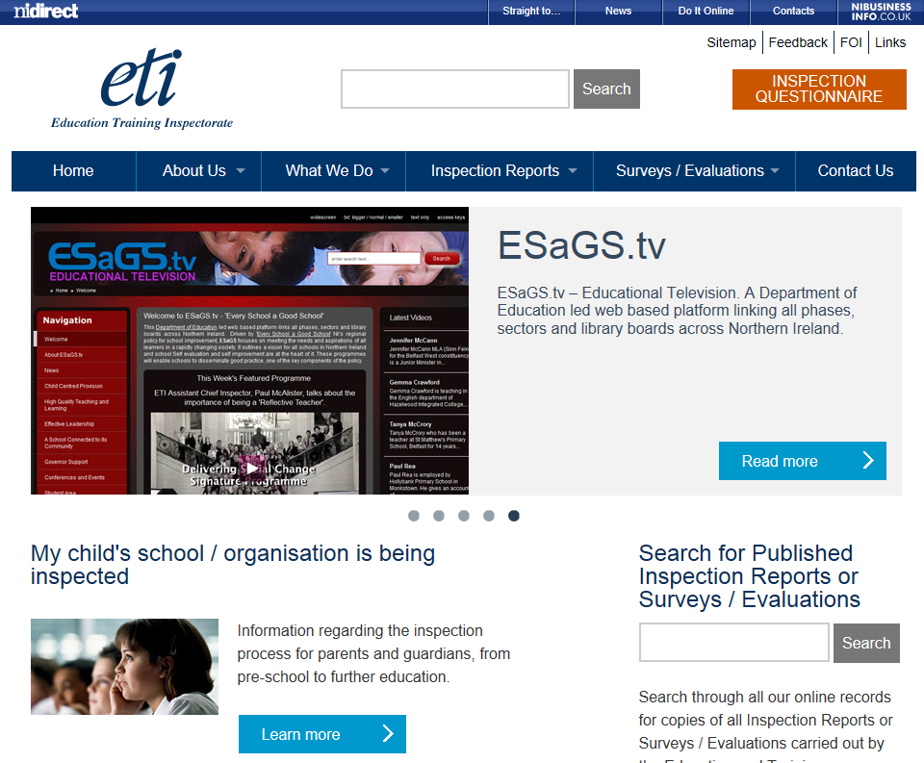
Support materials...
ETI Website www.etini.gov.uk:
New ETI website is planned for January 2016...

Slide 40
Karen McCullough
Head of Standards and Improvement Team

Slide 41
After Inspection
14th September 2015

Slide 42
Standards and Improvement Team’s response
S&I Team receives inspection report
All receive letter from the Department
Acknowledging receipt of report
Outlines next steps for Board of Governors
Reviewing School Development Plan
Flow chart

Slide 43
Outcome | Action
high level of capacity for sustained improvement | No further action by DE Build on positive outcomes
capacity to identify and bring about improvement | No further action by DE Action plan for internal use Template
needs to address (an) important area(s) for improvement | Action plan to department (30 days) FUI in 12-18 months

Slide 44
Needs to address urgently the significant areas for improvement
Requires support - Formal intervention process
Summary of key findings from ETI
Annex C of Every School a good school
Management response within 30 days
Action plan within 60 days
Follow up inspection 18-24 months

Slide 45
What Happens After Inspection?
David Beck
Managing Inspector

Slide 46
What Happens After Inspection?
Changes to the ETI follow-up process as a consequence of:
Changes to the overall effectiveness paragraphs indicating the inspection outcome.
Changes to Annex C of the Department of Education’s Every School a Good School Policy.

Slide 47
What Happens After Inspection?
Schools identified as having ‘Important Area(s) for Improvement’
Enter the Follow-up Inspection (FUI) process

Slide 48
What Happens After Inspection?
FUI process:
Interim Follow-up Visit (IFUV)
Follow-up inspection (usually 12-18 months after initial inspection)

Slide 49
What Happens After Inspection?
Schools having to ‘address urgently significant areas for improvement’
Enter the Formal intervention process (FIP)

Slide 50
What Happens After Inspection?
Safeguarding
If a school/organisation is afforded the descriptor ‘unsatisfactory’ for safeguarding/child protection, the ETI will return to monitor progress in addressing the safeguarding/child protection issues and, if necessary, the pastoral care issues which have been identified.

Slide 51
What Happens After Inspection?
Schools identified as having a high level of capacity for sustained improvement
And
Schools that have demonstrated the capacity to identify and bring about improvement in the interests of all the learners
Will enter the Sustaining Improvement Inspection (SII) programme (currently being piloted)

Slide 52
What Happens After Inspection?
The Sustaining Improvement Inspection (SII):
The aim of the SII is to monitor the school’s/organisation’s continuing action to sustain and effect improvement through its SDP and underpinning self-evaluation processes
The SII model places the onus of demonstrating sustained improvement in the hands of the leadership

Slide 53
What Happens After Inspection?
The SII is NOT a re-inspection of the school.
The SII IS focused on the capacity of the leadership to demonstrate through its SDP and self-evaluation processes that it has sustained improvement.
The written report will not contain lengthy detail on specific exemplary aspects of the provision.
The overall effectiveness is NOT re-graded.
The report is shared with the school but is not published (in this extended pilot).

Slide 54
ETI Handbook
John Anderson
Managing Inspector

Slide 55
ETI Handbook
PART ONE: The inspection process
The purpose of inspection
The organisations inspected
ETI’s principles, values and standards
Types of inspection

Slide 56
ETI Handbook
PART ONE:
ETI roles and responsibilities
The inspection process:
Before the inspection
During the inspection
After the inspection

Slide 57
ETI Handbook
PART ONE:
Quality assurance as part of the inspection process
Complaints procedure
Timeline for inspection
→

Slide 58
ETI’s quality assurance process findings reported back orally are provisional until the report is published
QA helps to ensure and demonstrate consistency across all areas of ETI’s work;
QA informs individual inspector and whole-organisation professional development by identifying further areas for improvement;
QA ensures good practice is highlighted and shared;
QA promotes further confidence in the quality of inspection work undertaken; and
QA promotes greater openness and transparency in inspection work undertaken. ←

Slide 59
ETI Handbook
PART ONE:
What happens after an inspection
Overall conclusions and follow-up guidance: Safeguarding and Child Protection

Slide 60
ETI Handbook
PART TWO
Making our evaluations – progress on grade descriptors
PART THREE
Phase-specific inspection processes

Slide 61
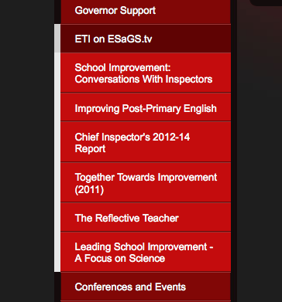
Online support resources about inspection
ETI videos on Inspection and Improvement
on ESaGS.tv
Links from
www.etini.gov.uk
“Ready to Go” room in C2k’s Fronter

Slide 62
at 11.30 – to 12.25 Post-primary inspection BRIEFING (olympic room)
Thank you and now please move to the appropriate room for the phase inspection briefing
PRIMARY inspection BRIEFING
(Titanic room)
WBL and FE inspection briefing
(britannic room)
Special/EOTAS Inspection briefing
(the Bridge)

Slide 63
Education and Training Inspectorate Inspection and improvement A Partnership
14 September 2015
NOELLE BUICK CHIEF INSPECTOR

Slide 64
Promoting improvement in the interest of all learners
ETI aims for the inspection process to:
be challenging but also positive and constructive
be highly credible and fully understood
be flexible and responsive to a changing landscape
demonstrate partnership working and collaborative responsibility
have a positive impact on improvement beyond the inspection itself.

Slide 65
Chief Inspector’s Report 2012-14 3 key messages
ASPIRE higher: focus on raising achievement and standards for all.
ENABLE more: support all learners through high quality learning & teaching, care, guidance and support.
EXPECT better: the importance of high quality leadership and management - leading to excellence.

