Slide 1
Post-primary model of inspection
14 September 2015

Slide 2
Content ...
Recent revisions to post-primary model
Guidance for principals/schools
Pre-inspection
The inspection
What happens after an inspection?
Questions/queries

Slide 3
Over the past two years, we have revised post-primary inspections to ...
Work in even greater partnership with those we inspect, particularly school leaders
Ensure we inspect the whole school
Take account of education reform
Strengthen the ETI improvement agenda
Create an improvement discussion to help build the school’s capacity for improvement
Report and write in a manner that is concise, clear and simple and meets the needs of all readers

Slide 4
Main Revisions ...
Focus on the SDP as central and on school processes (in particular self-evaluation)
The pre-inspection preparation day
School gives its own evaluation of achievements and standards
The class pursuit on day 1
An enhanced pupil voice through discussions with the pupils and piloting a pupil questionnaire (2015/16)
Meeting governors on day 2
Flexibility to follow up issues and for subjects (esp. En/ma) as necessary
Seeking even greater engagement with the school through
offer of joint lesson observations
the role of the representative

Slide 5
Guidance for Post-primary Principals 2015/16
Guidance available to principals on ETI website:
Together Towards Improvement: a process for self evaluation outlines the key questions and quality indicators which guide inspection and self-evaluation in post-primary schools.

Slide 6
Pre-inspection: Preparation for inspection
Inspection overview document
School self-evaluation of achievements and standards
Pre-inspection questionnaire for governors
Pastoral care and safeguarding proforma
Completion of online questionnaires
Role of the representative

Slide 7
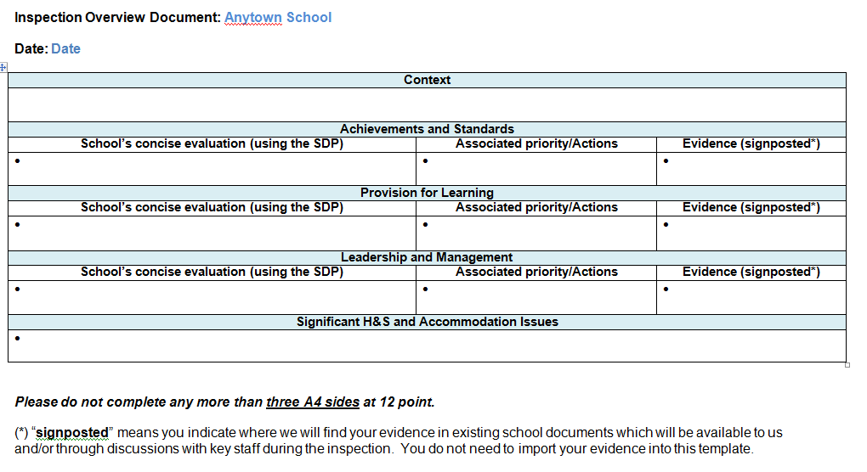
Inspection Overview Document
The overview document should contain an evidence-based evaluation of the quality of learning and teaching.

Slide 8
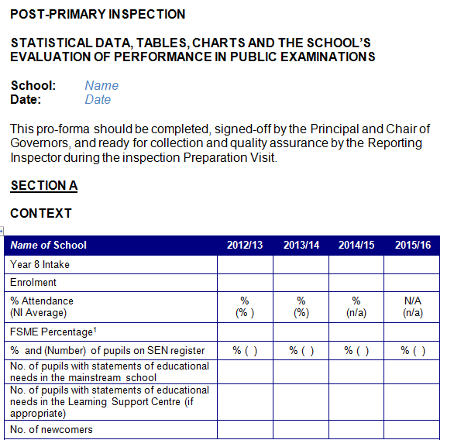
School’s evaluation of achievements and standards

Slide 9
Pre-inspection Preparation Visit
Preparation visit by RI to: - agree class pursuits - discuss role of representative - arrange principal’s short ‘briefing’ on morning of day 1 - agree governors meeting (day 2) - arrange report back - meet with key members of senior leadership team (SLT) - meet chair of governors (or a representative) - meet a group of pupils - check on progress with C2k data
Brief staff at the end of the school day
Collect relevant documentation - SDP and action plans - inspection overview document - achievements and standards proforma - governors proforma - safeguarding proforma

Slide 10
C2k Secondary School Information Disc (SSID)
C2k will engage with the school prior to inspection to collate the necessary SSID data files
Checked data is uploaded to C2k Exchange which is accessed by ETI; no further contact with C2k should be necessary
The accuracy and reliability of all data is the responsibility of the senior leaders in the school
During the inspection, any changes to SSID files are agreed with the RI and made by the school
Encourage proactivity with the use of data.

Slide 11
C2k Involvement (SSID) - 1

Slide 12
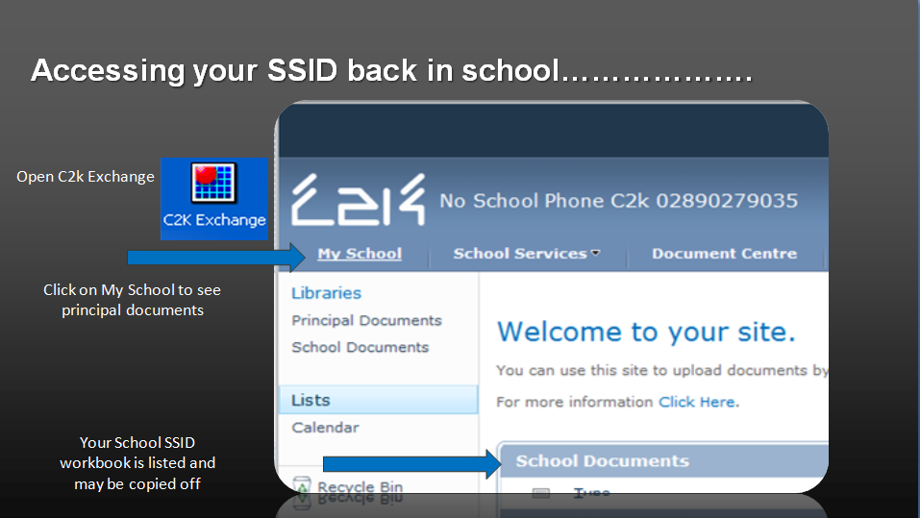
C2k Involvement (SSID) - 2

Slide 13
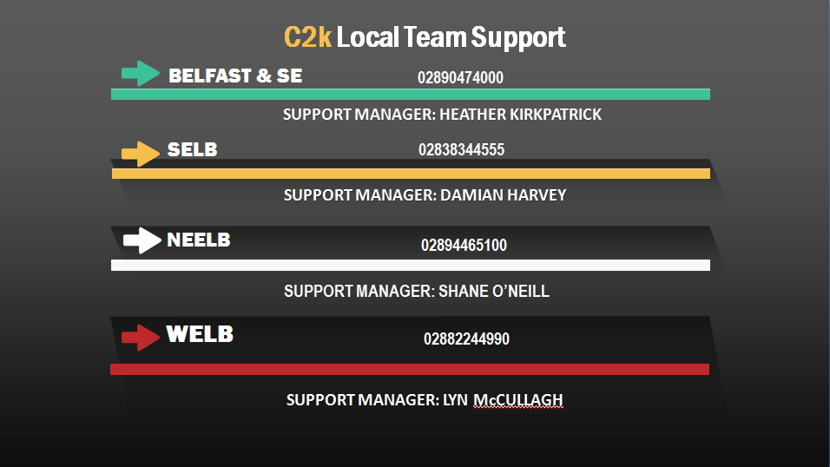
C2k Involvement (SSID) - 3

Slide 14
The inspection: Typical Post-Primary Team
Team members | Responsibilities
Reporting inspector | plans, manages and leads the inspection
Deputy reporting inspector | assists with all aspects of the inspection
Core team member | leads on the evaluation of care and support
Core team member | leads on the evaluation of the curriculum and careers education, information, advice and guidance (CEIAG)
Mathematics specialist | leads on the evaluation of mathematics and numeracy
English specialist | leads on the evaluation of English and literacy
Other subject specialist(s) | evaluates specialist subject(s)
Associate assessor(s) | contributes to the evaluation of areas within their professional expertise
Representative (voluntary) | a senior leader from the school manages the inspection process from within the school; attends the appropriate full inspection team meetings, including the moderation meeting.

Slide 15
Day 1
Day 1 | Activity
8.30 - 8.45 am | Team arrival; introductions.
Period 1 | Short ‘meet and greet’ by principal (maximum 15 minutes). Short team briefing, chaired by RI.
Period 1/2 (onwards) | Class pursuit lesson observations involving most team members. The principal or other senior manager will be provided with the opportunity to undertake some joint lesson observations with a member of the inspection team. RI commences meetings with principal and other senior managers and the scrutiny of documentation. Lead inspector for care & support selects pupils for inclusion in pupil interviews on day 2.
Last period | Team members complete/finalise learning insight profile
After school | Team meeting, attended by representative.

Slide 16
Day 2
Day 2 | Activity
Morning | Pupil discussions take place.
Morning/afternoon | Inspection activities continue, including lesson visits and discussions/meetings with key staff. Team meeting during last period, attended by the representative.
After school | RI and DRI (or AA) meet with representatives of the board of governors. Meetings are held between specialist inspectors and heads of department, co-ordinators, middle managers and staff with whole-school responsibilities.

Slide 17
Day 3
Day 3 | Activity
Morning | Inspection activities continue, including lesson visits and discussions with key staff. All lesson visits and discussions with staff are concluded by lunchtime. Professional dialogue takes place between specialist inspectors and representatives of the departments which have been inspected; this is completed before the end of lunchtime.
Afternoon | The RI, along with a team member, will meet with the principal and senior leadership team. The DRI works with the other inspection team members to collate whole-school inspection findings around care and support, curriculum, literacy, numeracy and ICT.
After school | Team meeting, chaired by the RI and attended by the representative.

Slide 18
Day 4
Day 4 | Activity
9.30 am | Team arrival
 | Moderation meeting Team meeting chaired by the RI, attended in full or part by the representative, to collate and discuss the findings from the inspection and to moderate and agree performance levels for the core areas of the inspection and the overall effectiveness conclusion for the school. Confidentiality around inspection findings by the representative is expected. A managing inspector (for example post-primary or quality assurance) will attend a significant number of moderation meetings, as part of the ETI quality assurance process.

Slide 19
Day 5
Day 5 | Activity
Time agreed with principal, governors and RI | RI and DRI report orally the key findings of the inspection. The performance levels and overall effectiveness conclusion fed back at the oral report back are provisional, and subject to adjustment as part of the ETI’s moderation and quality assurance process. At the oral report, the provisional conclusion to be used in the full written report will be shared with the school. The wording of the conclusion will indicate clearly to the school: the capacity of the school for sustained improvement; the level of follow-up activity; and the urgency of any actions for improvement. A summary of the key performance levels, the overall conclusion and any areas for improvement will be left with the school.

Slide 20
What Happens After an Inspection?
Completion of the ETI quality assurance process
Pre-publication copy of report (check for factual accuracy)
Publication of report
Written confirmation of receipt of report
DE School Improvement Team contact (request for an action plan if necessary)
Follow-up inspection activity (where necessary) - Annex C Every School a Good School (DE) - What Happens After an Inspection (ETI)

Slide 21
Questions?

