Slide 1
Inspection and Self-evaluation Framework (ISEF)
Inspecting Care and Welfare and Safeguarding
26 September 2017
John Anderson

Slide 2
Revised (Jan 2017) Inspection and Self-Evaluation Framework (ISEF)
Key areas remain:
Leadership and management
Quality of provision for learning
Outcomes for learners
Slimmed down to strengths/AFIs for 9 essential quality indicators
Holistic evaluations of care, welfare, safeguarding and governance
Inclusion of characteristics of best practice and challenge questions to support self-evaluation
ETI does not ‘inspect’ for the use of ISEF – schools are free to adapt suitable indicators (can continue to use TTI etc.) for their stage of development

Slide 3
ISEF
A more holistic overview
Consistent across all phases and sectors
Open and transparent
Focuses on the key aspects, not all aspects
Care, welfare and safeguarding are paramount
Designed to enable self-reflection leading to improvement
Not designed to be a check-list
Helpful to focus on key transition points
Useable at all stages of development of the organisation

Slide 4
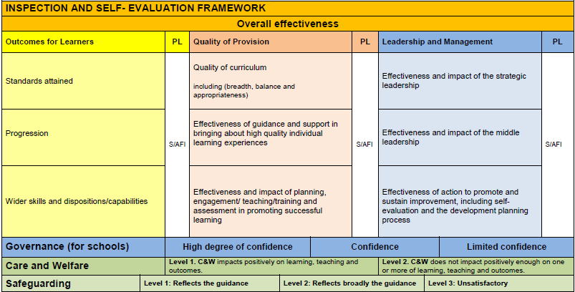

Slide 6
Outcomes for learners
Standards attained
Knowledge, skills and understanding across areas of learning
High expectations
Thinking skills, personal capabilities
Progression
Consistent and commensurate with ability
High quality assessment and feedback
Wider skills and dispositions
Self confidence and self-esteem
Resilience and positive engagement
Self-regulating
Skills, dispositions and values

Slide 7
Quality of provision
Quality of the curriculum
Broad, balance flexible
Meets individual needs
Socially inclusive and shared
Employability skills, including the use of ICT
Effectiveness of guidance and support
Addresses individual learning needs
Clear and realistic targets
Effectiveness and impact of planning, teaching and assessment
Planning reflects the curriculum
Builds on interests, needs and prior learning
A range of learning strategies
Assessment information informs planning

Slide 8
Leadership and management
Effectiveness and impact of strategic leadership
Shared, coherent and child-centred vision
Effective partnerships
Informed by action research
Career-long professional learning
Aligned and effective resource use
Effectiveness and impact middle leadership
Self-evaluation informs planning
Good practice identified and shared
Evidence of impact on outcomes
Effectiveness of action to promote improvement
Development planning is consultative and monitored
Priorities and action plans effect improvement

Slide 9
Observing , evaluating and reporting the quality of learning
The fundamental purpose of school is that all students learn and not merely that all students are taught.... It is a collective responsibility... that all students are making at least a year’s growth for a year’s input. Visible Learning for Teachers (Professor John Hattie)

Slide 10
Six components of good pedagogy ......in terms of impact on learning.
teacher’s deep subject knowledge and understanding of how learners think and make mistakes in their subject
effective questioning and use of assessment by teachers
high quality classroom interactions which, while being demanding, also recognise self-worth
effective classroom management which ensures a good pace of learning
teacher’s belief in what they are doing and why, including their understanding of how learning happens
the professional behaviour of reflective practice

Slide 11
How could this promote better learning?
Effective feedback to teachers raises and sustains the learners’ standards consistently ...
Ensures that teachers do not ‘plateau’ in their effectiveness after three to five years of teaching, but continue to improve
This is dependent on the school creating a supportive, reflective professional culture with (what the researchers call) a ‘knowledge-building cycle’

Slide 12
Sustained professional learning is most likely to result when feedback to teachers:
focuses on improving the learners’ outcomes
relates clear, specific and challenging goals for the teacher
attends to the learning, not to the person or to comparisons with others
encourages the teacher to continue to be an independent learner
mediates feedback in a trusting environment
promotes teacher professional learning through effective school leadership.

Slide 13
Governance
High degree of confidence
Confidence
Limited confidence

Slide 14
Governance ISEFs
Revised and updated in line with ISEF
Revised pre-inspection questionnaire for primary, special and post-primary school governors
Supports the role of governors to provide the school with both support and challenge
Now available online

Slide 16
The Children Act (Order 1995)
The child/YP’s welfare is paramount
The voice of the child/YP should be heard
Parents are supported to exercise parental responsibility and families helped to stay together
Partnership
Prevention
Responses should be proportionate
Protection
Evidence-based and informed decision making

Slide 17
Circular 2017/04
DE Circular 2017/04 Guide for Schools
Replaces 1999/10
The handbook Guide for Schools
… work in progress
Para 4.2 – recommends the use of the ETI Safeguarding Proforma

Slide 18
Articles 17 and 18 of the Education and Libraries (NI) Order 2003
The board of governors of a grant aided school has a statutory duty to:
safeguard and promote the welfare of registered pupils at the school at all times when the pupils are on the school premises or in the lawful control or charge of a member of school staff; and
decide on the measures to be taken by all persons associated with the school to protect pupils from abuse, whether at school or elsewhere, and review these measures from time to time.

Slide 19
The Schedule for Regulation 4 of The Education (School Development Plans) Regulations (NI) 2010
requires schools to monitor and review annually (Regulation 7) the progress made in the school’s approach to:
(c) promoting the health and well-being, attendance, good behaviour and discipline of pupils; and
(e) managing the attendance and promoting the health and well-being of staff.
The 2003 Order places a further obligation on the board of governors to prepare a written statement of such measures and to secure that copies of the statement are available for inspection at the school.

Slide 20
Care and welfare
a broader, outcomes-based evaluation of care and welfare: reported at two levels
ETI will not necessarily focus on how the organisation’s arrangements are structured and managed
unless concerns arise
the evaluation of care, welfare and safeguarding is a collective view made by the whole team
and is related to the evaluations on outcomes, quality of provision and leadership and management

Slide 21
Care and welfare
The school’s approach to….
Level 1. care and welfare impacts positively on learning, teaching and outcomes for learners
Level 2. care and welfare does not impact positively enough on one or more of learning, teaching and outcomes for learners

Slide 22
SAFEGUARDING
No significant changes to reporting
which remains at three levels.
An UNSATISFACTORY outcome leads to a 6-week follow-up.
If there is a significant risk or risks to children or young people then SG is unsatisfactory
The ETI Safeguarding Proforma is the recommended self-evaluation tool for schools to use (six different versions)
It is important that schools review SG for themselves – it’s not to keep ETI happy!

Slide 23
Safeguarding
Level 1. Arrangements reflect the relevant guidance
(of the Department of Education)
Level 2. Arrangements reflect broadly the guidance
training for one person, or a policy may be out of date by a short period
Health and Safety issues may be remedied immediately
Level 3. Arrangements are unsatisfactory
Follow up visit in 6 weeks

Slide 24
Lord Lamy
Professional curiosity
Respectful challenge

