Slide 1


INTRODUCTION
#BetterOffAtSERC
Innovative, Enterprising &
Entrepreneurial CULTURE

Slide 2

#BetterOffAtSERC
LEARNING REVOLUTION STRATEGY
Learning and Assessment Model
Digital Tools & Connectivity for Students
How should students learn and be assessed.
Project Based Learning (PBL)
01
04
Eportfolio, video calls, collaboration
Learning Revolution Strategy
Online & On-Campus
Enterprise & Entrepreneurship
02
05
Enterprise fortnight. Student EXPO. Entrepreneurs Club
Transversal skill development., PBL, Technical Skills
Staff CPD
Review and Evaluate
Staff need to unlearn old pedagogy skills and relearn new ones
03
06
Continuous review, evaluate and further enhancement. Share best practice and learn from others.

Slide 3

#BetterOffAtSERC
ENTREPRENEURIAL PYRAMID
Entrepreneurial
Business Mentoring
Ingenio
Get the Edge
Student Companies
SERC Monthly student fairs
Innovation
CAST/CAPS
CDIO
Innovation Funding
International Partnerships
‘R&D' Facilities
Enterprise
Project Based Learning - PBL
Competitions
Guest Speakers
Industry Visits
Student Volunteering
Student expo

Slide 4
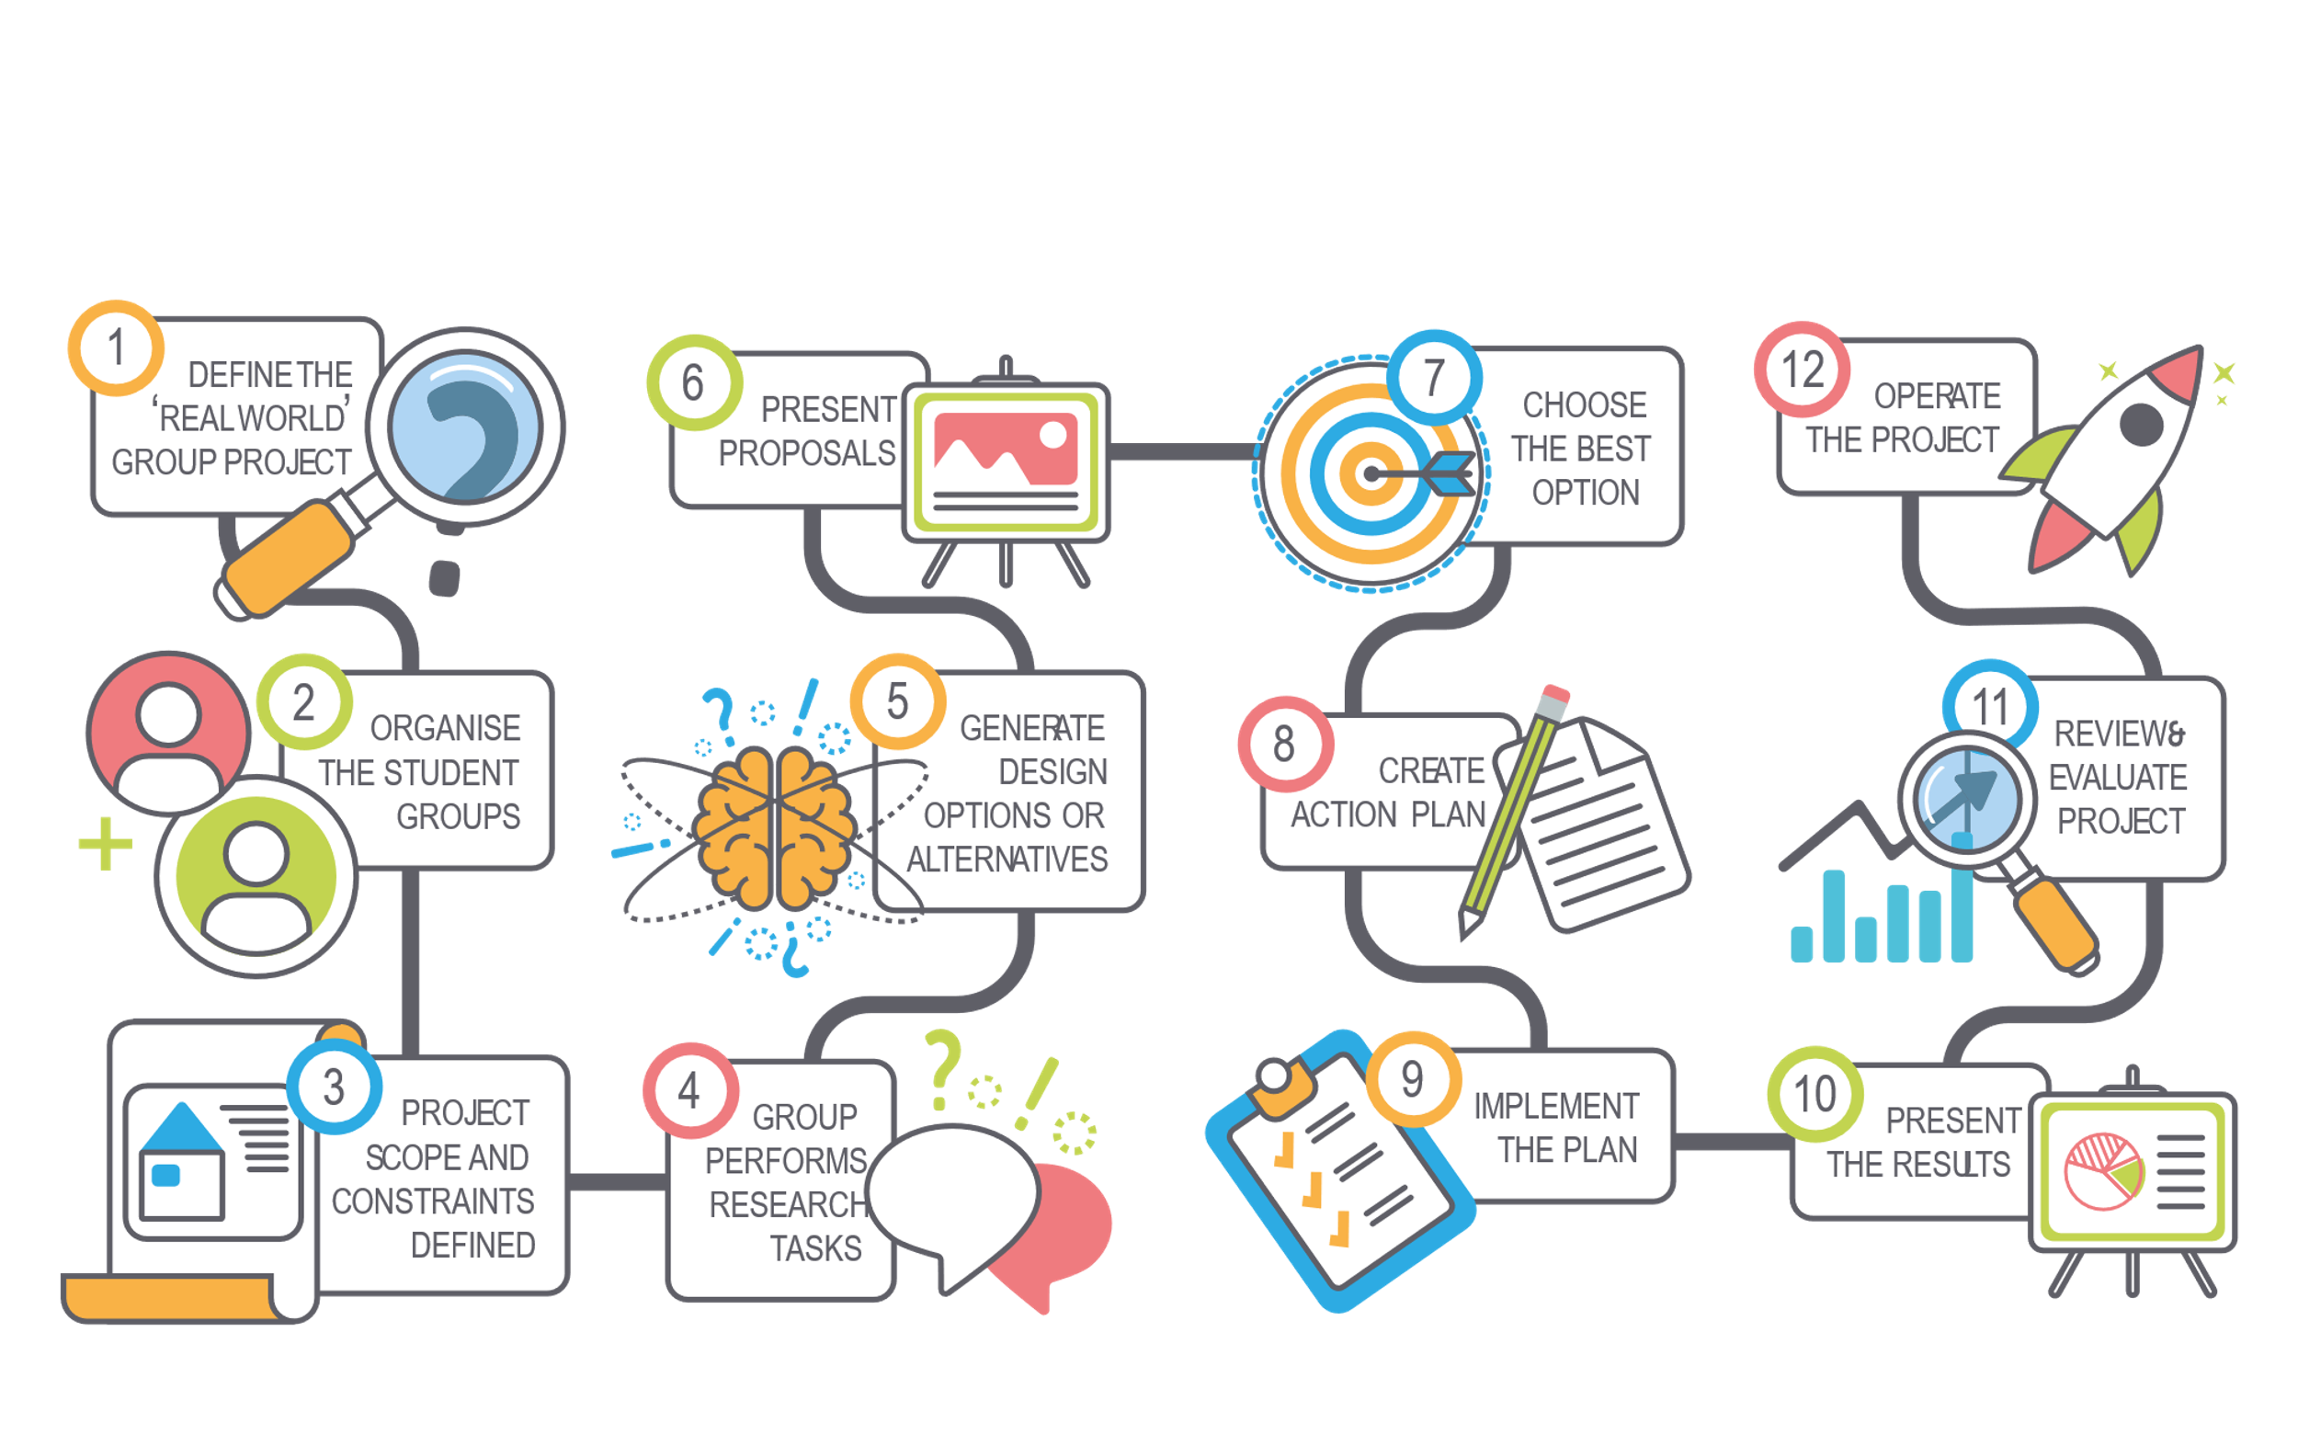
#BetterOffAtSERC
SERC PBL MODEL
SERC PBL Model
Developed a 12 stage model for PBL that runs across whole College
Based on Basque Country VET and Stanford University CDIO
Real-life projects & Student expos
Support through Intensive training with curriculum teams, pedagogy mentoring, enterprise & entrepreneurship team
Impact research study with Stranmillis University PBL
(An investigation of curriculum policy and practice)
International providers of training in PBL
E.G. Edge Foundation etc.

Slide 5






#BetterOffAtSERC
TRANSVERSAL SKILLS
Citizenship
Problem Solving
Respect for cultural diversity and your contribution to society.
The thought processes involved in solving a problem.
Digital Literacy
Transversal
Skills
Working With Others
Your ability to communicate and negotiate with others.
Using digital platforms to find, communicate and evaluate information.
Self Management
Work Professionalism
Students need to learn how to manage their tasks and priorities.
Your approach and attitude to study and work.

Slide 6

#BetterOffAtSERC
PBL THEMES
PBL Themes 20/21
Innovation - Sustainability - Safe & healthy living and learning.

Slide 7
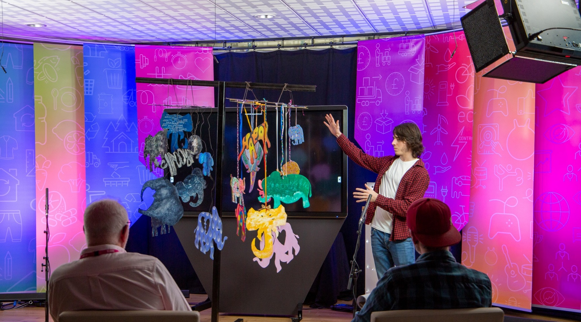
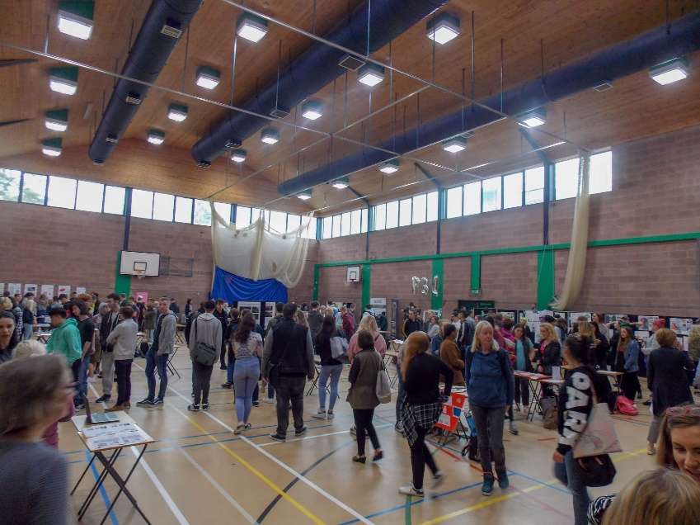
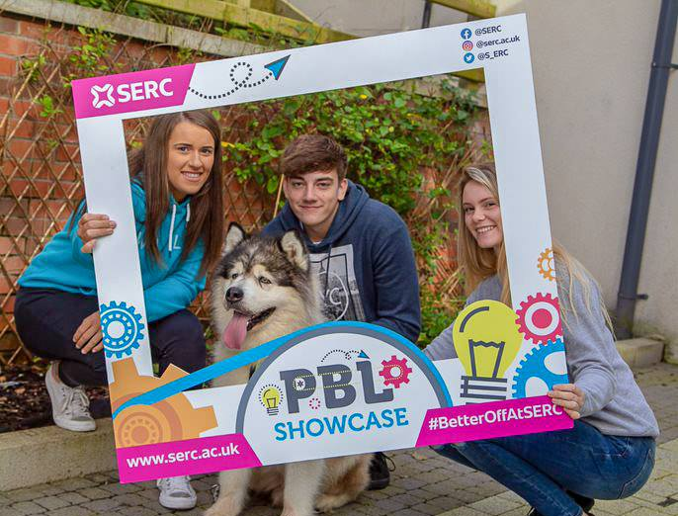
#BetterOffAtSERC
ENTERPRISE FORTNIGHT
Enterprise
Fortnight
Our Enterprise fortnight kickstarts that process for all students each September and has become a tradition at the College, providing an enjoyable way for students to embrace College life and network with other students
All FT students participate in a 2 week PBL project
Students assigned to groups
Projects planned to follow PBL Themes
Student EXPO at the end of the 2 weeks
Student projects judged by external Judges
Best Student groups compete in competition final

Slide 8
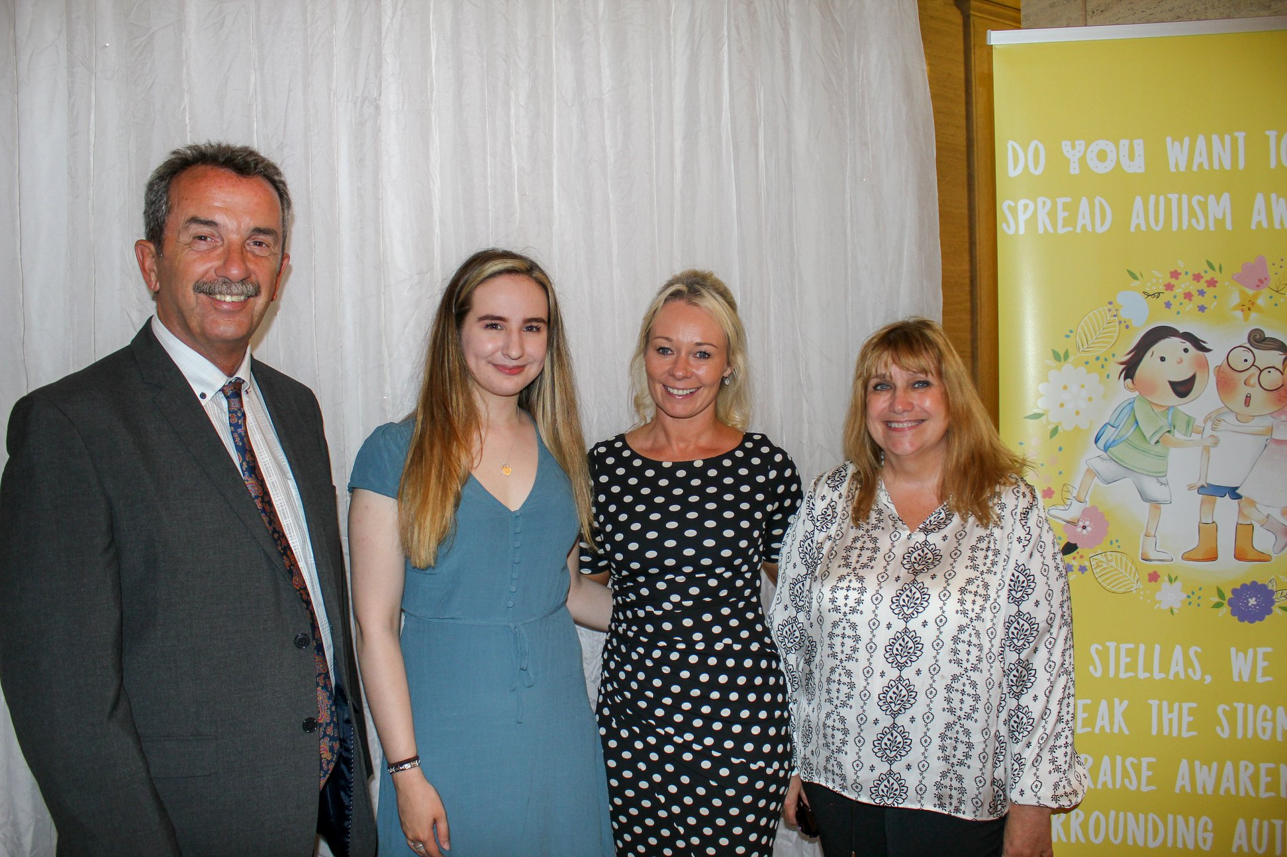
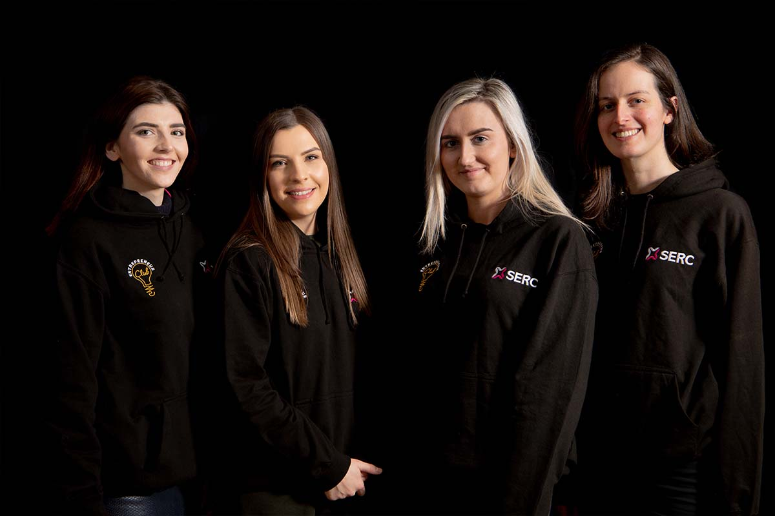
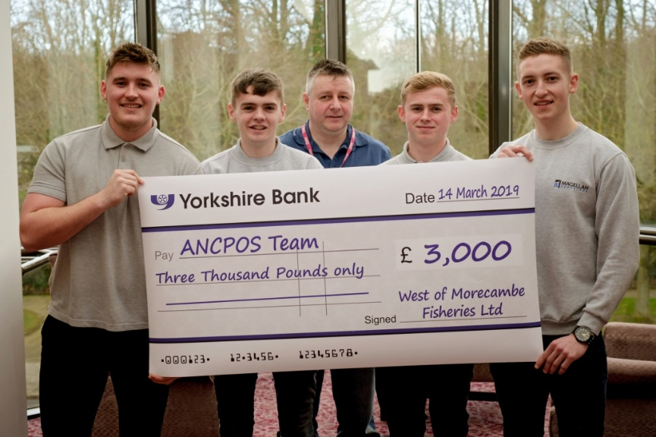
#BetterOffAtSERC
SUPPORTING ENTREPRENEURSHIP
Supporting Entrepreneurship
Our programs help students leverage their talents and tenacity to build a viable startup. We’ll train you in the skills and innovative thinking that allow founders to create successful businesses, challenging you to take a real startup from idea to execution and impact.
A Safe and Supportive Place to develop ideas and skills
Dedicated staff Two DHOS, four Innovation Advisors
Entrepreneurs Club
Leading Entrepreneurs and Mentors, Professor Terrence Brannigan, Chair of NITB is the Entrepreneur In Residence
Immediate immersion in Enterprise Fortnight
80+ Student Companies
Monthly trade fairs

Slide 9
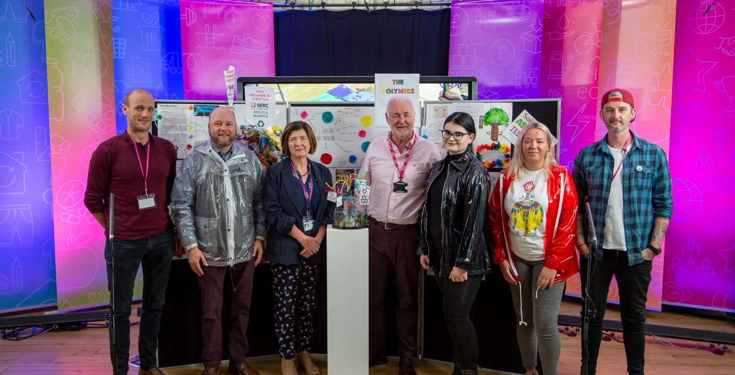
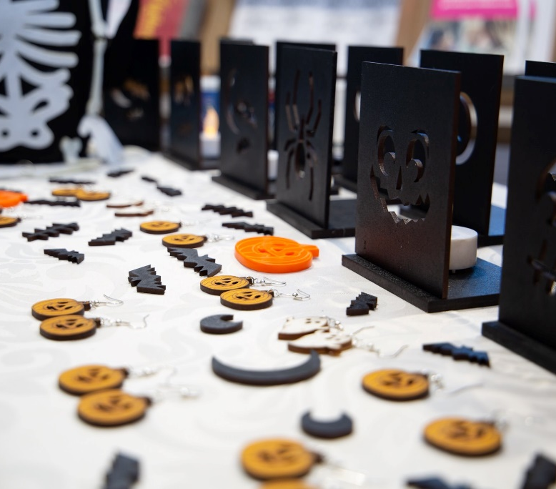
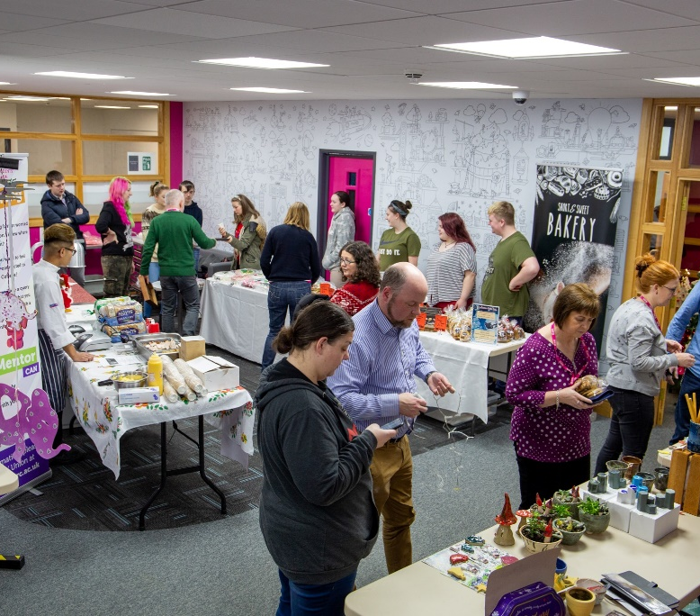
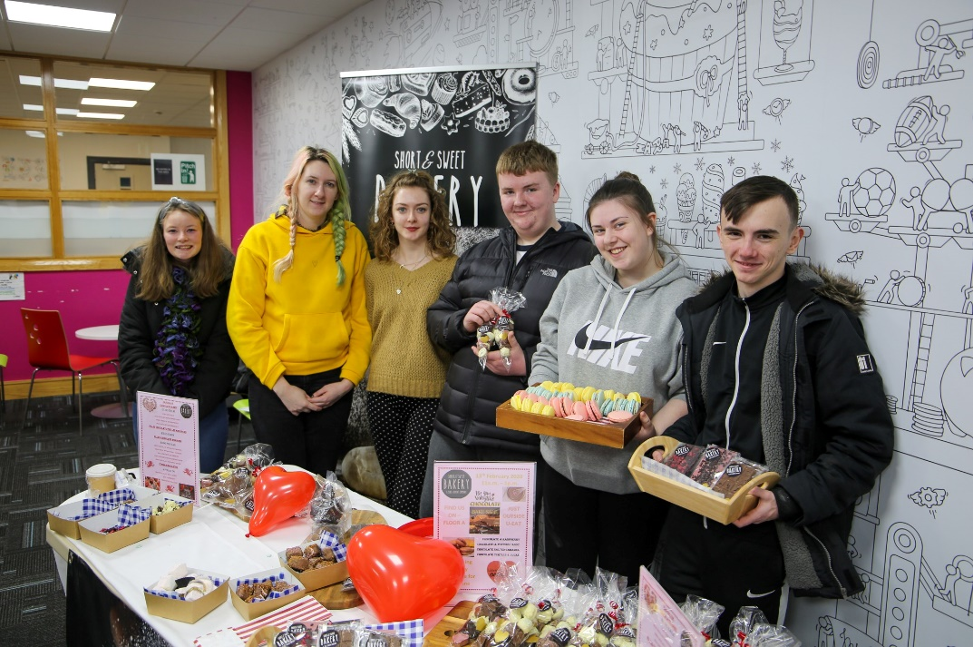
24
SEPT
Supporting Entrepreneurship
Students pitched their ideas, Dragons’ Den-style, to a prestigious panel of judges.
29
13
17
OCT
DEC
FEB
Halloween Markets showcasing idea & Products
Festive fairs, which have now become an annual event.
Valentine's Markets at the Bangor, Downpatrick, Lisburn and Ards campuses.

Slide 10




















24
SEPT
Over 80+ Student Companies

Slide 11

#BetterOffAtSERC
ENTREPRENEUR CLUB
Funding
Networking
Entrepreneur
Club
Trading Opportunities
Wrap-around
service
Mentoring
Workshops & Talks
Marketing

Slide 12
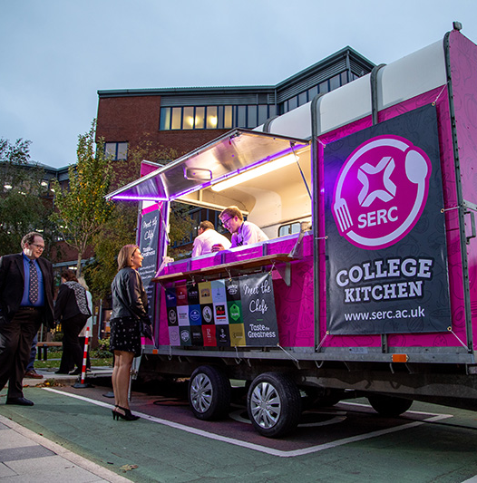
#BetterOffAtSERC
ETI INSPECTION
Developing Their Ideas Into Real Commercial Enterprises.
Where appropriate, through the college’s entrepreneur club, students can set up a student company with the aim of further developing their ideas into real commercial enterprises. The club supports students with innovative or business ideas, provides them with mentoring, workshops and networking opportunities. As a result, it is a significant strength that the college has supported the development of 84 student companies to date, across a range of different vocational areas;
Student Company College Kitchen catering for a College event in their internally design & built horse box.

Slide 13
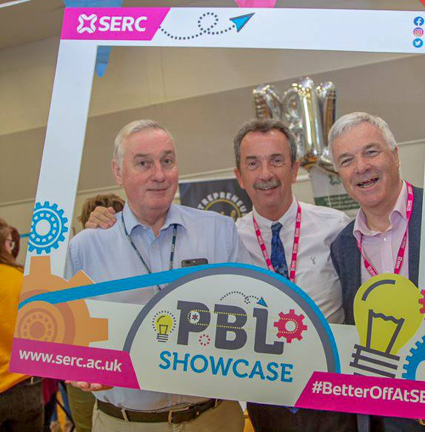
#BetterOffAtSERC
ETI INSPECTION
Sector-Leading
Project-Based Learning
A sector-leading project-based learning delivery model has been developed that aims to better integrate the development of the students’ vocational and transversal skills, through well-considered project themes and real-life projects. The college has developed extensive links nationally and internationally to research and support the development of this approach to learning. Through their engagement in the projects, students find solutions to real-world challenges and have formal opportunities to review and evaluate the success of their projects.

Slide 14
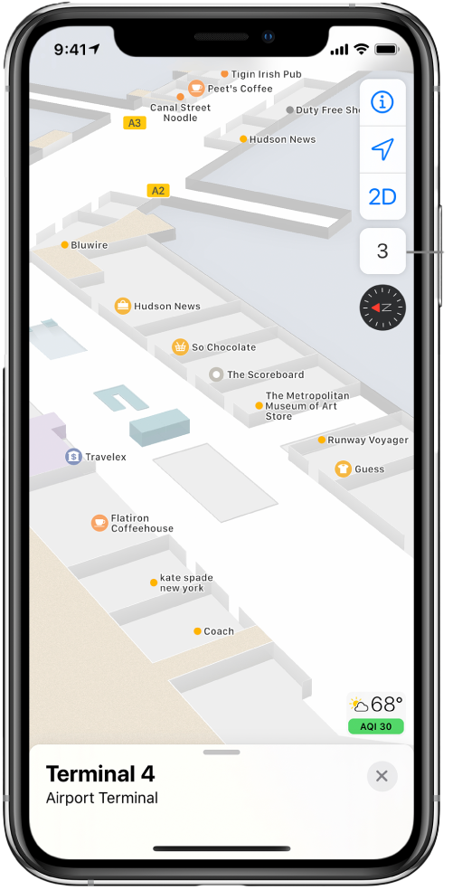
STUDENT SUCCESS
#BetterOffAtSERC
IT Crowd (Navigator)
Conor Smith, Andrew Harding & Aaron Millar
Studying HND Computing
An Indoor positioning system is essentially a GPS for an indoor environment. They are currently used in hospitals, shopping centres, and airports for example.
IPS uses the internal sensors in smartphones along with complex mathematical algorithms to calculate the location of the smartphone, combining this with a broadcasting beacon in classrooms will provide a route for the user to take.
Mentoring by EIR Terence Brannigan and the SERC information technology systems development team.

Slide 15
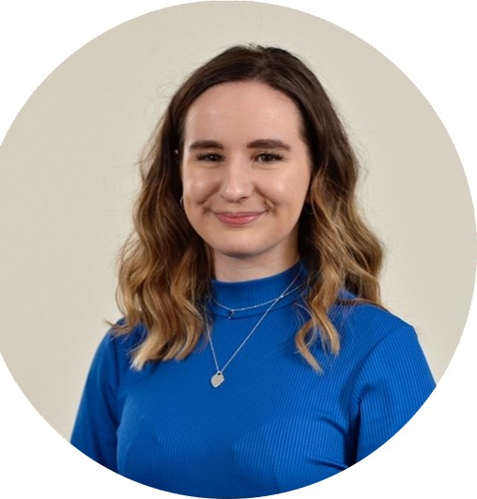
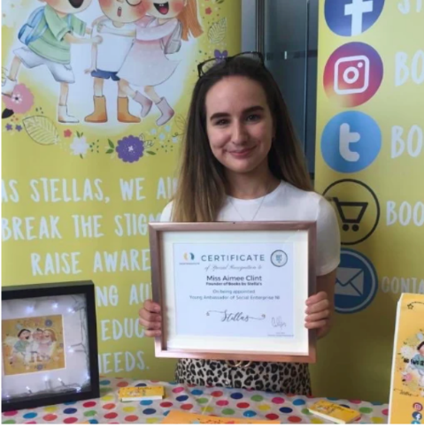
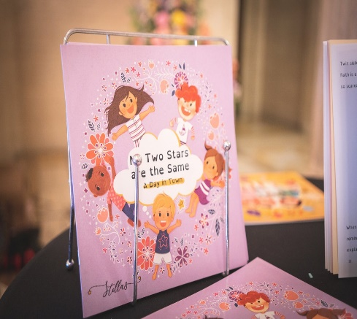
STUDENT SUCCESS
#BetterOffAtSERC
Aimee Clint - Author
"Books By Stellas"
SERC L3 Business Studies Student 2018 – 2020.
Founder member of SERC Entrepreneur Club.
Co-Founder Books By Stellas CIC,
Published Author 'No Two Stars Are The Same'.
' No Two Stars Are The Same – A Day In Town'
Highly commended Young Business Woman of the Year.
Winner - TransferWise 20 Under 20 winner 2019,
Young Ambassador for Social Enterprise NI,
One Young World Ambassador,
The Youth Group Youth Advisory Board Member, WISE100,
SERC Alumni.
Mentoring EIR Terence Brannigan, SERC Enterprise Team

Slide 16
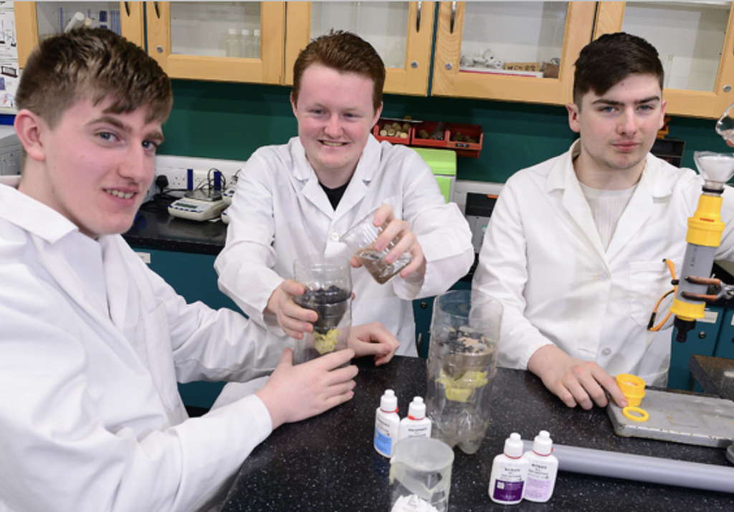






STUDENT SUCCESS
#BetterOffAtSERC
The Water Boys
Martin McKeown, Johnny McQuillan & Paul French
L3 National Foundation Diploma in Applied Science.
Prototyped a low-cost, low-tech solution to the problem of water contaminated by nitrates and phosphates.
Their solution is a physical and chemical filter which removes 90% of nitrates from polluted water and a high level of phosphates. 1 in 10 people do not have access to clean water close to home. (WHO/UNICEF Joint Monitoring Programme (JMP) Report 2019)
Finalist Eco Unesco 2020.
Finalist Student Catalyst INVENT 2020
Mentoring EIR Terence Brannigan, SERC Enteerprise Team
Interest shown by

